Slide 1

Organizational Behavior
(MGT-502)
Lecture-45

Slide 2
Today’s Topics

Slide 3

OB………
IN A GLANCE

Slide 4
In OB, everything depends. . .
But you need to know on what !

Slide 5
Organizational Behavior

Slide 6
Organizational Behavior
. . . a field of study that investigates the impact that individuals, groups and structure have on behavior within organizations, for the purpose of applying such knowledge toward improving an organization’s effectiveness.
Notes:
This material is found in more detail on pages 7-9.

Slide 7
Forces reshaping the process of management

Slide 8


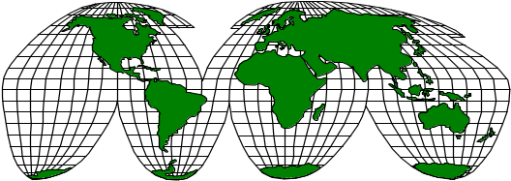
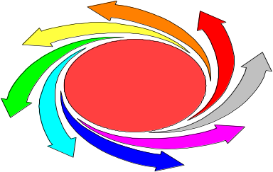
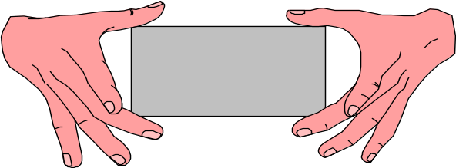
Power of Human Resources
Cultural Diversity
Globalization
Employer-
Employee
Rapid Change
New Psychological Contract

Slide 9
Organizational Behavior
The study of individual behavior and group
dynamics in organizational settings
Organizational Variables
Performance appraisal Work design
Communications
Human Behavior
Organizational Design
Organizational Structure Jobs
Notes:
2

Slide 10
Behavior is a function of both the Person and the Environment.
B = f (P/E)

Slide 11
Understand
organizational
events
Organizational
Behavior
Research
Influence
organizational
events
Predict
organizational
events

Slide 12
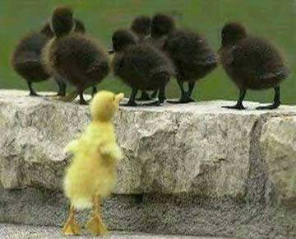
OB
Systematic study of how people behave in organizations

Slide 13
What is an Organization?
A structured social system consisting of groups and individuals working together to meet some agreed-upon objectives.

Slide 14
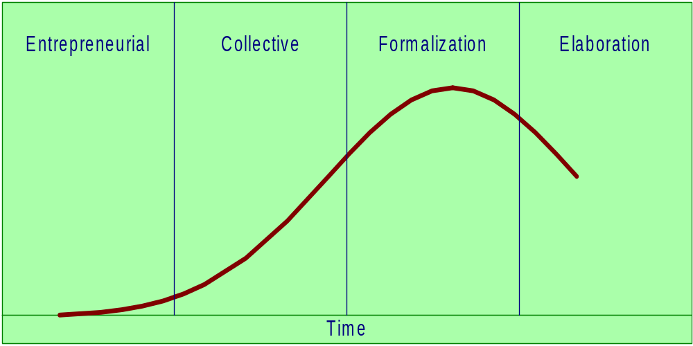

Slide 15
Stages in the Organizational Life Cycle
1) Entrepreneurial: The creation stage of an organization; founder managers do most jobs, work long hours, set the climate of the organization
2) Collective: The organization begins to take shape; division of labour occurs; control, responsibilities & levels of autonomy are established
3) Formalization: Formal roles become established; strategic & operational concerns are differentiated; co-ordination & control become desired goals
4) Elaboration: The stage of renewal which follows the increasing rigidity of the formalization stage

Slide 16
Organizational Strategy
Mission
What we are or want to be?
Specific Goals
What must be achieved? When?
Strategy
What will we do to get there?

Slide 17
Basic OB Model
Organization
systems level
Group
level
Individual
level

Slide 18
Variables Influencing
Individual Behavior

Slide 19
The Person
Skills & abilities
Personality
Perceptions
Attitudes
Values
Ethics
The Environment
Organization
Work group
Job
Personal life
Behavior
B = f(P,E)

Slide 20
Behavior
Motivation
Perceptions
Attitudes
Values

Slide 21
Individual Level Factors
Values, Attitudes
Personality & Emotions
Ability
Perception
Attribution
Motivation

Slide 22
Group & Interpersonal Factors
Group Structure
Team Characteristics & Development
Leadership
Conflict
Power & Politics

Slide 23
Organizational Factors
Organization Structure
Work Design
Organization Culture

Slide 24
What is Organizational Behavior?
Refers to the attitudes and behaviours of individuals and groups in organizations.
Studies how organizations can be structured more effectively and how events in their external environments affect organizations.

Slide 25
Why Study
Organizational Behavior?
It is interesting because it is about people and human nature.
  Includes interesting examples of success and failure.
  Provides tools to find out why people behave the way they do.

Slide 26
It is important to managers, employees and consumers.
Understanding organizational behaviour makes more effective managers, employees and consumers.

Slide 27
Organizational behaviour has a powerful influence on the attitudes and behaviours of individuals in organizations.
Organizational behaviour can impact financial performance.

Slide 28
The Nature of Organizational Behavior
Environment
Human Behavior in Organizational Settings
The Individual-Organization
Interface
The Organization
Environment

Slide 29
Organizational Behavior
Objectives
  Understand behavior
  Predict behavior
  Control behavior
Evaluate
  Personal Factors
  Situational Factors
Derived from
  Psychology
  Sociology
  Social Psychology
  Anthropology
  Political Science

Slide 30
Some Key Trends Impacting OB
Diversity and Demographic Changes
Globalization
Changing Social & Ethical Values & Expectations of
  Employees, Customers, Investors, General Public
Rapid Technological Change
Changing Management Initiatives
  Teams, Empowerment, Downsizing, Temporary Employment

Slide 31
Learning About OB Through A
Combination of Theory, Research, and Practice
Theory
Research
Practice
Most complete
information for
better
understanding
and managing
organizational
behavior

Slide 32
Developing an OB Model
Dependent Variables
  Productivity
  Absenteeism
  Turnover
  Job Satisfaction
Independent Variables
  Individual-Level Variables
  Group-Level Variables
  Organizational Systems-Level Variables

Slide 33

The History of OB
The Early Days: Scientific Management and the Hawthorne Studies
Classical Organizational Theory
Late Twentieth Century: Organizational Behavior as a Social Science
OB Today: The Infotech Age

Slide 34
The Historical Backdrop
Structural Perspectives
  Scientific Management
  Classical School
  Bureaucracy
Behavioral Perspectives
  Human Relations School
  Group Dynamics
  Decision Theory
  Leadership

Slide 35

Historical Timeline of the Emergence of Organizational Behavior
Organizational Behavior
The Human Relations Movement
The Hawthorne Studies
The Classical Perspective
The Scientific Management Era
1900 1925 1950 1975 2000

Slide 36
OB in a Performance Context
Competitive Environment
Resource Suppliers
Customers
People
Culture
Structures
Technologies
Strategy
implementation
Organization
Tasks

Slide 37

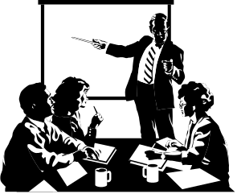


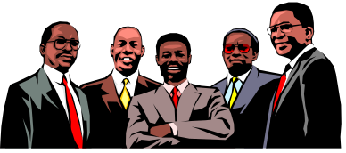

Bank Customers
Board of
Directors
Investment
Unit
Manager
Stockholders
Employees

Slide 38
Competencies Required for Managers
Adaptability
Knowledge about State-of-the-Art Practice
Intercultural Competencies
Information Technology Skills
Critical Thinking Skills
Creativity
Interpersonal Effectiveness

Slide 39
The Skill Triangle
Task Skills
Interpersonal Skills
Decision-making Skills

Slide 40
How To Develop Team Synergy
Support
Focus on Quality
SYNERGY
Listen and Clarify
Consensus
Decision Making
Disagree Constructively
Acceptance of Member Skills
Notes:
This should

Slide 41

Responding to Changes in Expectations
Increasing Flexibility in Response to Employees’ Needs
The Quality Revolution
Corporate Social Responsibility

Slide 42
Shifting Paradigms of Organizational Behavior
  Demise of “command-and-control.”
  Emergence of new workplace expectations.
  Critical role of information technologies.
  Belief in empowerment.
  Emphasis on teamwork.
  Concern for work-life balance.

Slide 43

Prominent Trends
The rise of global businesses with culturally diverse workforces.
Rapid advances in technology.
The rising expectations of people in general.

Slide 44

Shifting Demographics
More women are in the workforce than ever before.
Ethnic diversity is reality.
People are living – and working – longer than ever before.

Slide 45

Alternative forms of organization
Global matrix structures
Networks
Joint ventures
Strategic alliances
Voluntary organizations
Non-profit organizations

Slide 46
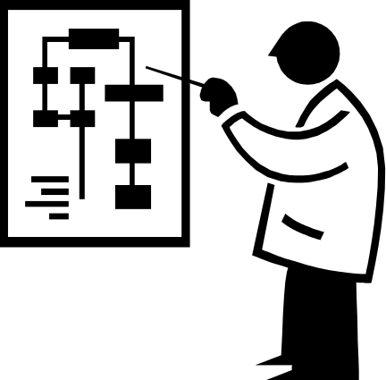
Challenges and Opportunity for OB
Responding to Globalization
Managing Workforce Diversity
Improving Quality and Productivity
Responding to the Labor Shortage
Improving Customer Service

Slide 47
Challenges and Opportunity for OB (cont..)
Improving People Skills
Empowering People
Stimulation Innovation and Change
Helping Employees Balance Work/Life Conflicts
Improving Ethical Behavior

Slide 48
Understand
organizational
events
Organizational
Behavior
Research
Influence
organizational
events
Predict
organizational
events

Slide 49
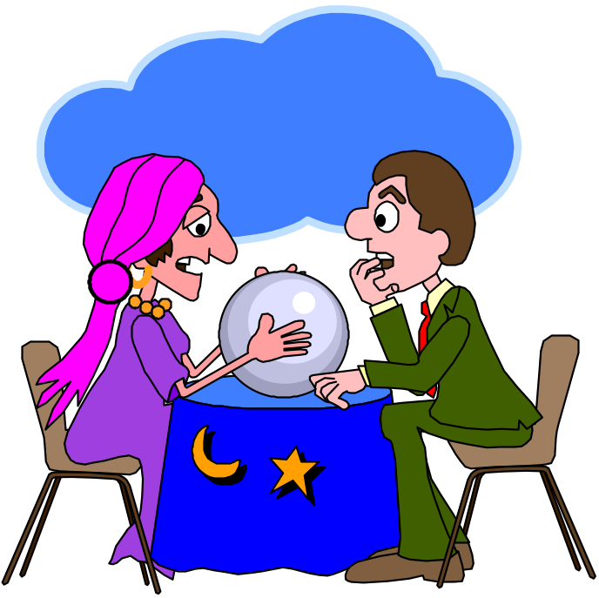
Issues for the future
Learning organizations
Virtual organizations
Intellectual capital
Growth of the small business sector
Globalization
Increasing importance of business ethics

Slide 50
Modern Workplace Trends
  Commitment to ethical behavior.
  Importance of human capital.
  Demise of “command and control.”
  Emphasis on teamwork.
  Pervasive influence of information technology.
  Respect for new workforce expectations.
  Changing definition of “jobs” and “career.”

Slide 51


Watchwords for Organizations in These Changing Times

Slide 52
The Challenge of Change
Too much change = chaos
Too little change = stagnation
How do you view change?
Opportunity
Threat

Slide 53
“Knowledge and experiences are available but often ignored”

Slide 54
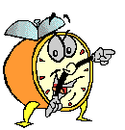
Let’s stop it here

Slide 55
Organizational Behavior
(MGT-502)
Lecture-45

